Slide 1
A Systematic Review of Bayesian Articles in Psychology
The Last 25 Years
Author: van de Schoot
Reporter: Xiaokai Xia

Slide 2

Author: Rens van de Schoot
Institution
Royal Netherlands Academy, AP
Academic credentials
H-index: 29
Citations: 12965
Strategic themes
Dynamics of Youth
Areas of expertise
Bayesian statistics
longitudinal data analysis
multilevel analysis
structural equation modeling

Slide 3
Publication: Psychological Methods
H index: 122
SJR: 4.02
Scope
Devoted to the development and dissemination of methods for collecting, analyzing, understanding, and interpreting psychological data
Care about the innovations in research design, measurement, methodology, and quantitative and qualitative analysis to the psychological community

Slide 4
Highlights
Works
The Bayesian approach to statistics is gaining in popularity over the last 25 years
Systematic review 1579 articles
Identify trends and see how Bayesian methods have been integrated into psychological research
Results
Bayesian statistics is used in a variety of contexts across subfields of psychology
This methodology can be used in a flexible manner to tackle many different forms of questions

Slide 5
Introduction
The focus of Bayesian method

Slide 6
Intro of Bayes
Publish
Thomas Bayes, 250 years ago, inverse probability
Simon-Pierre Laplace, 200 years ago

Slide 7
Intro of Bayes
Publish
Thomas Bayes, 250 years ago, inverse probability
Simon-Pierre Laplace, 200 years ago
Current Bayes’s theorem

Slide 8
Intro of Bayes
Publish
Thomas Bayes, 250 years ago, inverse probability
Simon-Pierre Laplace, 200 years ago
Inverse probability
probability distribution
unobserved variable
Bayes’s theorem
moderate prior beliefs regarding the model parameters
updated beliefs about model parameters

Slide 9
Summarize the application of Bayes
Bayesian tools have not been at the forefront of modern-day applied statistics
A steady increase in the popularity of Bayesian statistics outside of psychology
organizational science
IRT models
health technology
epidemiological and medical
……

Slide 10
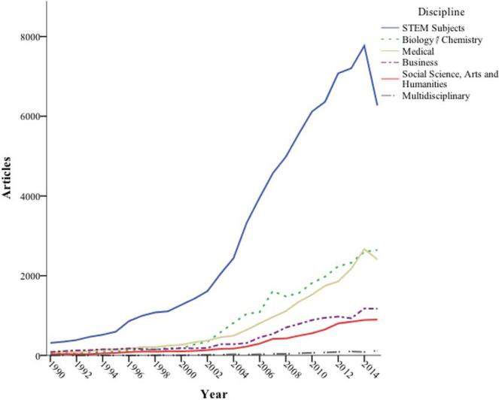
STEM = Science, Technology, Engineering, and Mathematics.

Slide 11
Method
Bibliometrics: statistical analysis of written publications

Slide 12
Bibliometrics
Definition
statistical analysis of written publications
Usage
provide quantitative analysis of academic literature
determine the popularity and impact of specific articles, authors, and publications, gauge the importance of one's work
assess the core journal titles and watershed publications
assess interrelationships between authors from different institutions
Method
literature search
trace relationships among academic journal citations
Calculate the key index (H-index, g-index)
Bibliographic network matrices

Slide 13
Method
Step 1: Search Strategy
Step 2: Initial Inclusion and Exclusion Criteria
Step 3: Assessment of Bayesian Usage
Step 4: Detecting Trends

Slide 14
Method
Step 1: Search Strategy ( on SCOPUS )
articles published between 1990 and 2015
inclusion mentioned “Bayesian,” “Gibbs sampler,” “MCMC,” “prior” or “posterior distribution”
the MCMC estimation algorithm is implemented in conjunction with observed data, and a prior
published in a “psychology” listed
also included: “arts and humanities,” “business,” “decision sciences,” “economics,” or “sociology.”
Step 2: Initial Inclusion and Exclusion Criteria
Step 3: Assessment of Bayesian Usage
Step 4: Detecting Trends

Slide 15
Method
Step 1: Search Strategy
Step 2: Initial Inclusion and Exclusion Criteria
The initial screening was done based on abstract
Read the full article to assess classification if we need more information
Step 3: Assessment of Bayesian Usage
Step 4: Detecting Trends

Slide 16
Method
Step 1: Search Strategy
Step 2: Initial Inclusion and Exclusion Criteria
Step 3: Assessment of Bayesian Usage
Read the full-text to screen those articles for Bayesian content
Identified several categories representing different types of Bayesian articles
Step 4: Detecting Trends

Slide 17
Method
Step 1: Search Strategy
Step 2: Initial Inclusion and Exclusion Criteria
Step 3: Assessment of Bayesian Usage
Step 4: Detecting Trends
Read the full text in order to adequately describe these trends
Trend information for each article was summarized in Excel

Slide 18
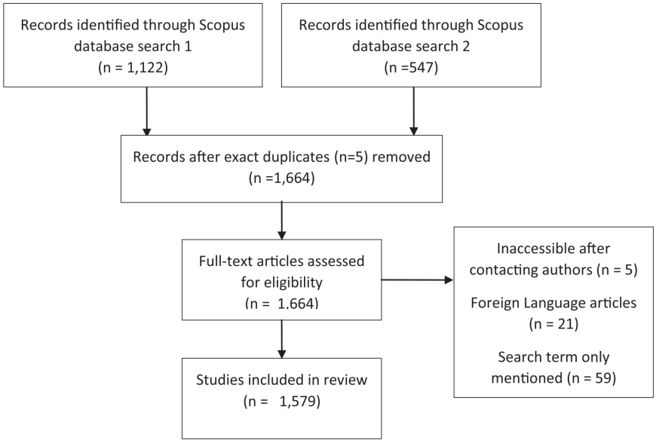

Slide 19
Result
Summaries of the statistical results

Slide 20
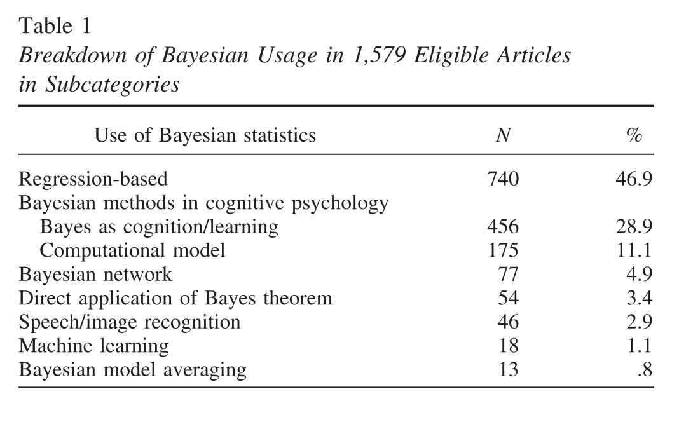
Summary of the screening process

Slide 21
Summary of the screening process
“regression-based” models (with MCMC)
regression analysis, ANOVA, CFA, SEM, IRT, multilevel modeling
Cognitive psychology
Bayes as cognition
Bayes as a model to explain behavior
Computational model
A model attempted to imitate a human “Bayesian” thinker in the experiment task
Bayes Networks analysis
Education
Cognitive psychology (Fenton, Neil, & Lagnado, 2013)
Neuroscience (Zhang et al., 2015)

Slide 22
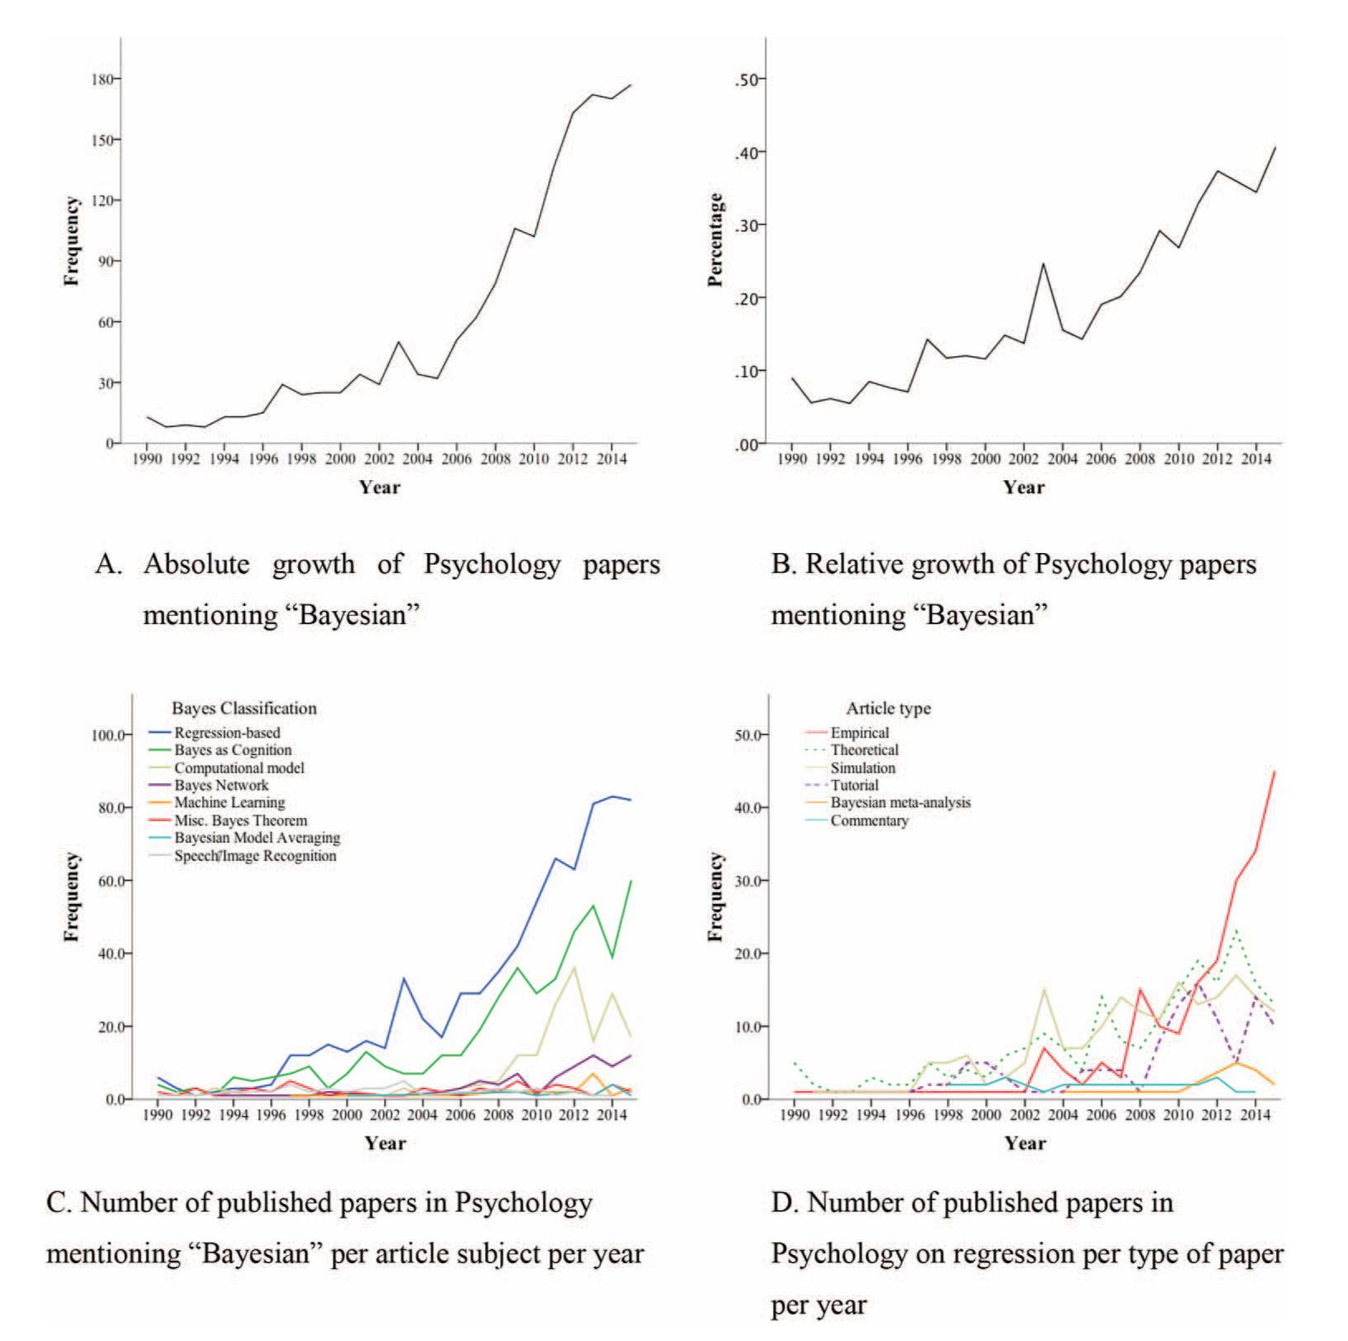
Trends of Bayesian Method

Slide 23
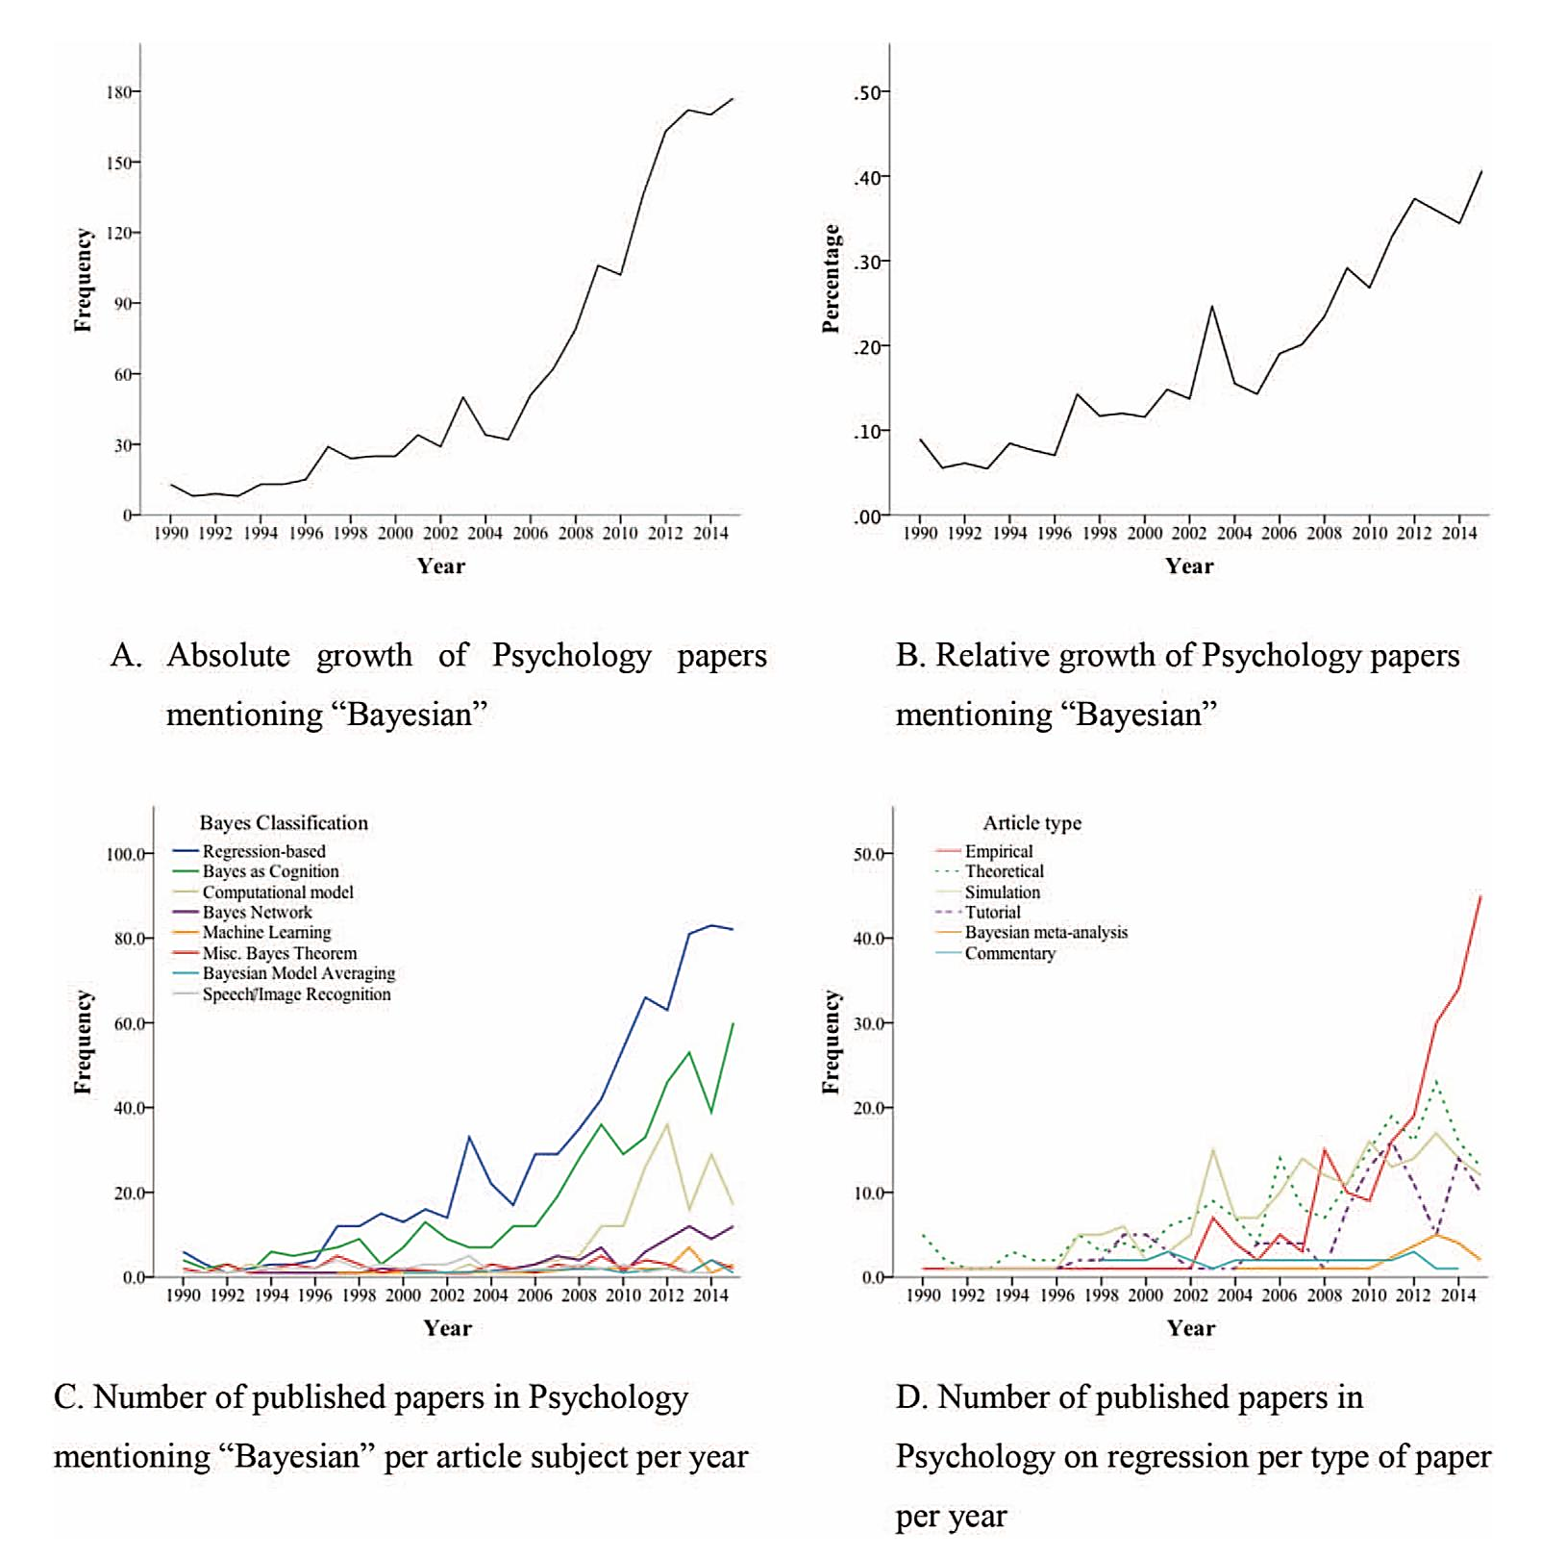

Slide 25
Bayesian Journals
50% of all articles were published in just 19 of 269 journals
“Experimental psychology” is the most popular subject category
There are journals within most areas of psychology that are open to publishing studies based on Bayesian analysis
Many of these journals rank high within their respective subfields

Slide 26
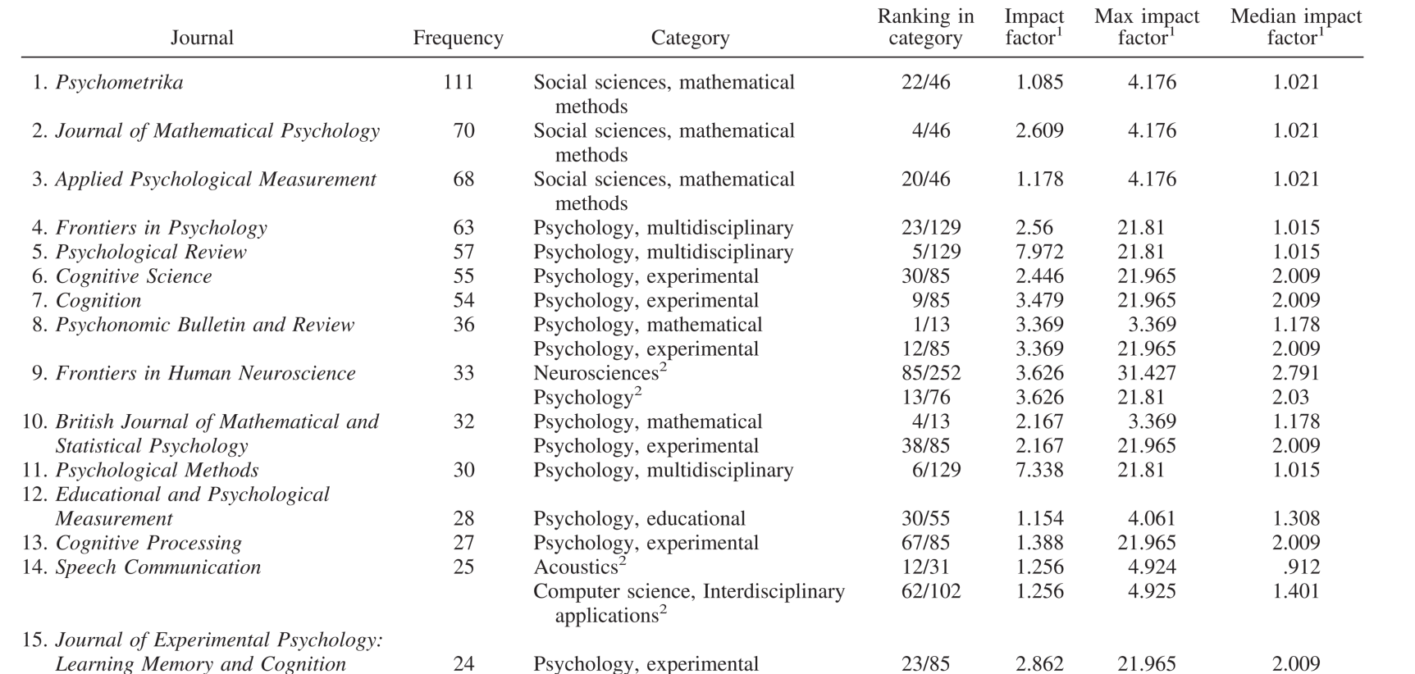
Bayesian Journals

Slide 27
Details in each method
Regression · Small samples · IRT · SEM · CAT

Slide 28
Regression-Based Models
Technical/Theoretical Articles
Simulation Articles
A large part of the regression-based Bayesian articles
Bayesian estimation typically outperforms other estimation methods
Empirical Regression-Type Articles
Field
Reasons why researchers use Bayesian statistics
Bayesian software
Priors & Sensitivity analysis
Convergence & Model fit
Model selection
Deviance information criterion

Slide 29
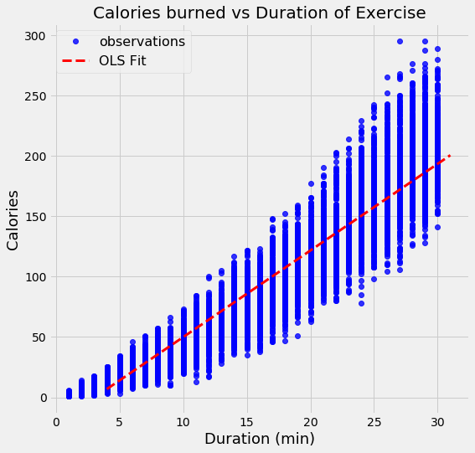
Empirical Regression-Type Articles

Slide 30
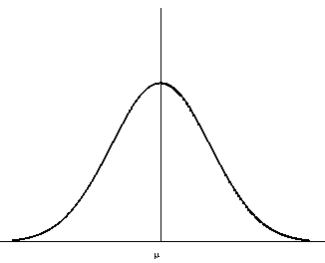
Empirical Regression-Type Articles

Slide 31

Empirical Regression-Type Articles
$$y \sim N(μ= α+ βx, σ= ε)$$

Slide 32
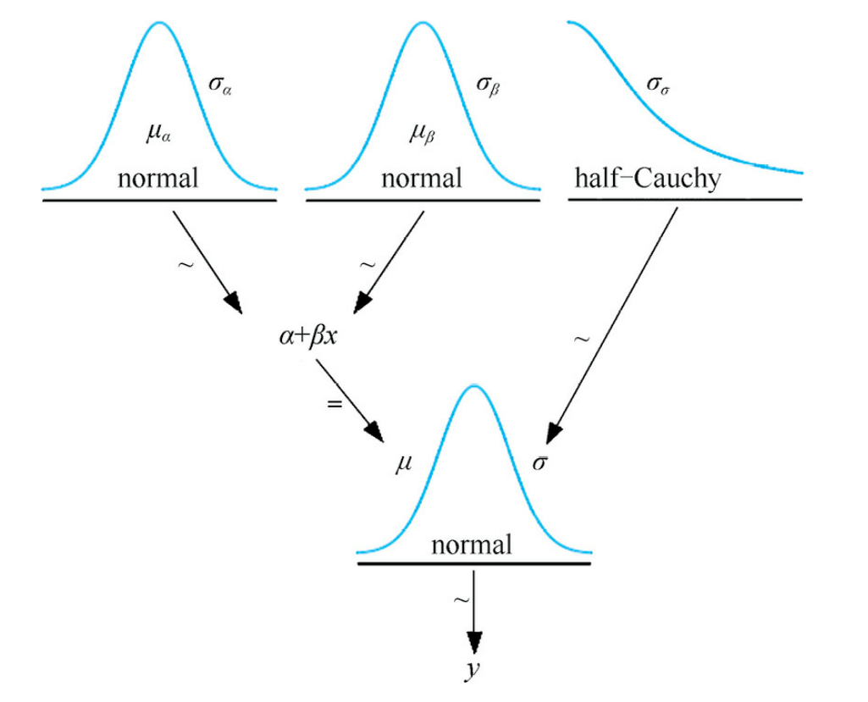
Empirical Regression-Type Articles

Slide 33
Empirical Regression-Type Articles

Slide 34
Empirical Regression-Type Articles
Reasons why researchers use Bayesian statistics
Robust
complex models simply cannot be estimated using other approaches (Ryoo et al., 2015, 27.5%)
to produce more accurate parameter estimates (Wilson, Barrineau, Butner, & Berg, 2014)
missing data handling (e.g., Bulbulia et al., 2013; 3.6%)
improved performance for small sample sizes (14.4%)
modeling flexibility (10.8%)
Use more information
use of (informative) priors (12.6%)
the Bayesian model selection tools available (14.4%)
Modeling uncertainty
Notes:
对前提假设的要求没有那么高
适用于小样本的数据，因为可以反复估计，且因为已经存在先验知识，所以使得结果更为鲁棒

Slide 35
Empirical Regression-Type Articles
Software
WinBUGS was the most popular Bayesian program being used in regression-based articles until 2012
From 2013–2014, only 8.8% of empirical articles used WinBUGS
JAGS (17.5% in 2015) and Mplus (20.0% in 2015) are becoming much more popular
JASP, Stan (Carpenter et al., in press; Kruschke, 2014), and blavaan are promising new programs

Slide 36
Trends Across Categories
Small Samples
The more information a researcher can specify (via the prior) before seeing the data, the smaller the sample size needed to obtain the same certainty¹
Statistics
37 simulation articles that examined the performance of Bayesian methods in small samples
Many of the articles reported improvements
(e.g. IRT model (75), Mediation Model (25), CFAs (10-20), SEM(23))
Reason
Informative priors usually contained correct information about the parameter
1. Rouder, J. N., Sun, D., Speckman, P. L., Lu, J., & Zhou, D. (2003). A hierarchical Bayesian statistical framework for response time distributions. Psychometrika, 68, 589 – 606. http://dx.doi.org/10.1007/ BF02295614

Slide 37
Trends Across Categories
Item Response Theory
the largest modeling group represented in this category of technical articles
Only 8.9% of the applied Bayesian articles used IRT techniques
Structural Equation Modeling
The number of Bayesian SEM applications has experienced a dramatic spike since about 2012
Computerized Adaptive Testing
Bayesian applications of CAT are sparsely published (1.8%)

Slide 38
Bayes’s Theorem in Cognitive Psychology
Plays a major role in cognitive psychology in various ways

Slide 39
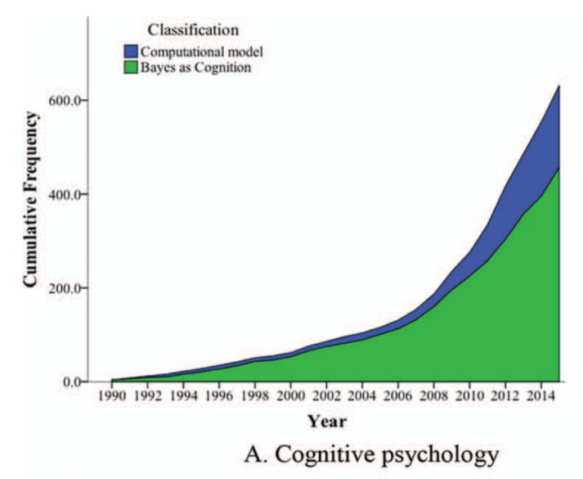

Slide 40
Cognitive modeling¹
The uses for Bayesian statistics in the cognitive sciences
Statistician: Using Bayesian methods for conducting standard analyses of data
Theoretician²: Bayesian methods as a working assumption about how the mind makes inferences
Related models of psychological processes to data³
Lee, Michael D. (2011): How cognitive modeling can benefit from hierarchical Bayesian models. In Journal of mathematical psychology 55 (1), pp. 1–7. DOI: 10.1016/j.jmp.2010.08.013.
Sanborn, Adam N.; Griffiths, Thomas L.; Shiffrin, Richard M. (2010): Uncovering mental representations with Markov chain Monte Carlo. In Cognitive psychology 60 (2), pp. 63–106. DOI: 10.1016/j.cogpsych.2009.07.001.
Shiffrin, Richard M.; Lee, Michael D.; Kim, Woojae; Wagenmakers, Eric-Jan (2008): A survey of model evaluation approaches with a tutorial on hierarchical bayesian methods. In Cognitive science 32 (8), pp. 1248–1284. DOI: 10.1080/03640210802414826.
Notes:
理论家：认为人的认知过程可以用一个公式来解释，且该公式用MCMC方法可解。论文先用简单的认知任务证实可以用MCMC解释人的行为，然后再用MCMC方法解读复杂的识别动物的任务

Slide 41
Cognitive modeling¹
The uses for Bayesian statistics in the cognitive sciences
Statistician: Using Bayesian methods for conducting standard analyses of data
Theoretician²: Bayesian methods as a working assumption about how the mind makes inferences
Related models of psychological processes to data³: Computational Model
Lee, Michael D. (2011): How cognitive modeling can benefit from hierarchical Bayesian models. In Journal of mathematical psychology 55 (1), pp. 1–7. DOI: 10.1016/j.jmp.2010.08.013.
Sanborn, Adam N.; Griffiths, Thomas L.; Shiffrin, Richard M. (2010): Uncovering mental representations with Markov chain Monte Carlo. In Cognitive psychology 60 (2), pp. 63–106. DOI: 10.1016/j.cogpsych.2009.07.001.
Shiffrin, Richard M.; Lee, Michael D.; Kim, Woojae; Wagenmakers, Eric-Jan (2008): A survey of model evaluation approaches with a tutorial on hierarchical bayesian methods. In Cognitive science 32 (8), pp. 1248–1284. DOI: 10.1080/03640210802414826.
Notes:
理论家：认为人的认知过程可以用一个公式来解释，且该公式用MCMC方法可解。论文先用简单的认知任务证实可以用MCMC解释人的行为，然后再用MCMC方法解读复杂的识别动物的任务

Slide 42
Cognitive modeling¹
The uses for Bayesian statistics in the cognitive sciences
Statistician: Using Bayesian methods for conducting standard analyses of data
Theoretician²: Bayesian methods as a working assumption about how the mind makes inferences
Bayesian hierarchical modeling
Lee, Michael D. (2011): How cognitive modeling can benefit from hierarchical Bayesian models. In Journal of mathematical psychology 55 (1), pp. 1–7. DOI: 10.1016/j.jmp.2010.08.013.
Sanborn, Adam N.; Griffiths, Thomas L.; Shiffrin, Richard M. (2010): Uncovering mental representations with Markov chain Monte Carlo. In Cognitive psychology 60 (2), pp. 63–106. DOI: 10.1016/j.cogpsych.2009.07.001.
Shiffrin, Richard M.; Lee, Michael D.; Kim, Woojae; Wagenmakers, Eric-Jan (2008): A survey of model evaluation approaches with a tutorial on hierarchical bayesian methods. In Cognitive science 32 (8), pp. 1248–1284. DOI: 10.1080/03640210802414826.
Notes:
理论家：认为人的认知过程可以用一个公式来解释，且该公式用MCMC方法可解。论文先用简单的认知任务证实可以用MCMC解释人的行为，然后再用MCMC方法解读复杂的识别动物的任务

Slide 43
Cognitive modeling
Bayesian hierarchical modeling
Method
Attempt to relate models of psychological processes to actual data
Advantage
Easy to be contributed: Allows the researcher to create a detailed model of the processes
Easy to be validated: Compare predictions of behavior from this model with observed data of actual human behavior
Notes:
理论家：认为人的认知过程可以用一个公式来解释，且该公式用MCMC方法可解。论文先用简单的认知任务证实可以用MCMC解释人的行为，然后再用MCMC方法解读复杂的识别动物的任务

Slide 44

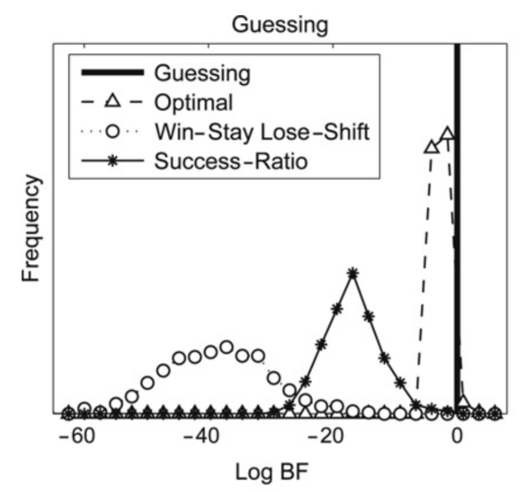


Cognitive modeling
Direct application of Bayesian statistics on observed data
Method
ANOVA, t-test based BF
Usage
Select various computational models¹ ²
the distribution of the three log BF measures over simulated participants whose data were generated by
each of the four models
Andrews, Mark; Vigliocco, Gabriella; Vinson, David (2009): Integrating experiential and distributional data to learn semantic representations. In Psychological Review 116 (3), pp. 463–498. DOI: 10.1037/a0016261.
Steyvers, Mark; Lee, Michael D.; Wagenmakers, Eric-Jan (2009): A Bayesian analysis of human decision-making on bandit problems. In Journal of mathematical psychology 53 (3), pp. 168–179. DOI: 10.1016/j.jmp.2008.11.002.
Notes:
win-stay lose-shift, success ratio, and optimal models
贝叶斯因子：每个trials的每个选项，能在当时的分布中得到一个估计值。然后看一下被试的行为反应有多支持这个结果。

Slide 45
Cognitive modeling
Contributions
Accounting for variation coming from sources like individual differences in cognition
The capability to account for observed behavior in terms of the combination of multiple different cognitive processes
Using a few key psychological variables to explain behavior on a wide range of cognitive tasks
The conceptual unification and integration of disparate cognitive models
Lee, Michael D. (2011): How cognitive modeling can benefit from hierarchical Bayesian models. In Journal of mathematical psychology 55 (1), pp. 1–7. DOI: 10.1016/j.jmp.2010.08.013.

Slide 46
The key point of Bayesian
Priors · Sensitivity analysis · Model fit · Model selection

Slide 47
Priors
31.1% of the articles did not even discuss the priors
8.4% of these articles that the reason was that default priors from the software were implemented
24% of the articles did not provide enough information to reproduce the prior settings (i.e., hyperparameters)
Sufficient information
Hyperparameters (43.1%)
The type of distribution
The level of informativeness (56.4%)
The source of prior information
Specifying priors: conjugate (45%)
• previous research • logical reasons • expert opinions

Slide 48
Sensitivity analysis
What
Understanding how changes in the model inputs influence the outputs
When
Prior is informative
Prior combined with small data
Why
Illustrating the role of the prior in the analysis
How¹
Formulating uncertainty in the model inputs by a joint probability distribution
Analyzing the induced uncertainty in outputs
1. Oakley, Jeremy E.; O'Hagan, Anthony (2004): Probabilistic sensitivity analysis of complex models: a Bayesian approach. In J Royal Statistical Soc B 66 (3), pp. 751–769. DOI: 10.1111/j.1467-9868.2004.05304.x.
Notes:
对模型输入进行小的改变之后，看看输出的改变受多大的影响

Slide 49
Model fit
Posterior predictive p values (ppp-values, 19.2%) can quantify model fit
Ppp-value: the chi-square value, based on the observed data to the simulated data¹
Replicated data generated under the model should look similar to observed data²
Ppp-values around .50 indicate a well-fitting model
Meng, Xiao-Li (1994): Posterior Predictive $p$-Values. In The Annals of Statistics 22 (3), pp. 1142–1160. DOI: 10.1214/aos/1176325622.
Gelman, Andrew; Carlin, John B.; Stern, Hal Steven; Dunson, David B.; Vehtari, Aki; Rubin, Donald B. (2014): Bayesian data analysis. Boca Raton: CRC Press (Chapman & Hall/CRC texts in statistical science).

Slide 50
Model selection
Two method
Bayes Factor (18.5%)
The deviance information criterion (DIC 22.8%)

Slide 51
Model selection
Bayes Factor (BIC)
Usage
Classical null hypothesis testing
assessing the level of support of the null hypothesis
Evaluating informative hypotheses
Advantage
“Updating” the model can reanalyzed data
Replicating results
Using prior information from other study

Slide 52
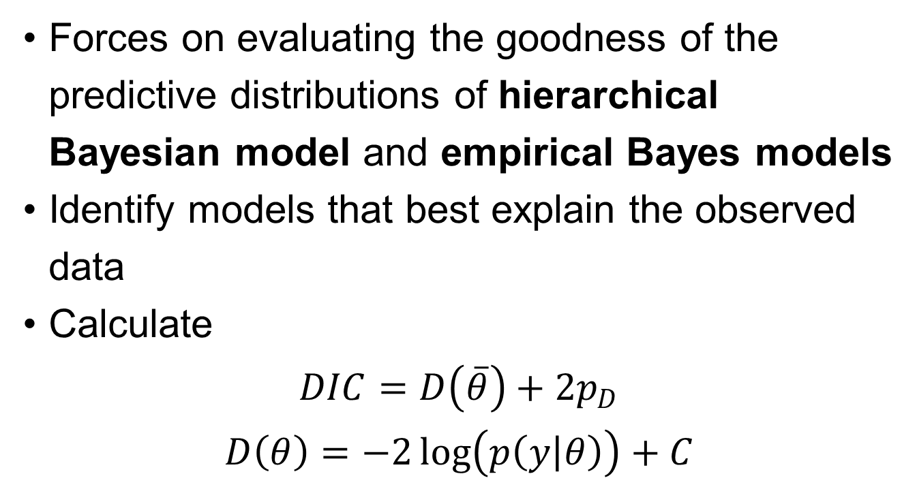
Model selection
Deviance information criterion
Forces on evaluating the goodness of the predictive distributions of hierarchical Bayesian model and empirical Bayes models
Identify models that best explain the observed data
Calculate
$$DIC=D\left(\overline{θ}\right)+2p_{D}$$
$$D\left(θ\right)=−2\log\left(p\left(y | θ\right)\right)+C$$

Slide 53
Discussion

Slide 54
Discussion
Bayesian statistics is used in a variety of contexts across subfields of psychology
There are many different reasons why one might choose to use Bayes
Ultimately, Bayes can be used in a flexible manner to tackle different forms of questions
The slow growth in popularity of Bayesian methods up to around the year 2010
Taught to think the null hypothesis
Very complex optimization/ integration problems are more prone to the Bayesian concept

Slide 55
Discussion
Using Bayesian methods requires the generation of knowledge
Thinking of parameters in terms of distributions
Specifying priors
Bayesian analyses are not immune to phenomena related to the replication crisis in science

Slide 56
My harvest
Building the framework of Bayesian method

Slide 57
My harvest
A glimpse of Bayesian method in psychology
The framework of Bayesian method in cognitive psychology
Significant researchers and reviews
The principle modeling method
How to select model
Some ignored point
Sensitive analysis
Ppp-value

